Slide 1
How to read your Work Schedule and further guidance

Slide 2
Work Scheduling Guidance
A host organisation/Placement site will be responsible for ensuring that a generic work schedule is prepared for the post and sent to the trainee 8 weeks prior to them starting in placement, which takes into account:
The expected service commitments.
The parts of the relevant training curriculum that can be achieved in the post.
Work Commitments/Working hours.
Details of Supervisors/GoSW.
Rolling rota.
Pay attached to the rota.
In your first meeting with your supervisor, you will discuss the generic schedule and personalise it further for you, according to your needs.
Following your meeting with your supervisor if any changes are made to your work schedule this must be
sent to the Lead Employer Team.

Slide 3
Exception Reporting & Work Schedule Reviews
The purpose of exception reports is to ensure prompt resolution and / or remedial action to ensure that safe working hours are maintained. The purpose of work schedule reviews is to ensure that a work schedule for a doctor remains fit for purpose.
Exception reporting is the mechanism used by doctors to ensure compensation for all work performed and uphold agreed educational opportunities.
Doctors can use exception reporting to inform the employer when their day-to-day work varies significantly and/or
regularly from the agreed work schedule. Primarily these variations are likely to include (but are not limited to):
differences in the total hours of work (including opportunities for rest breaks). differences in the pattern of hours worked.
differences in the educational opportunities and support available to the doctor. differences in the support available to the doctor during service commitments.
Further information regarding work schedules & exception reporting can be found in the T&Cs here: https://www.nhsemployers.org/publications/doctors-and-dentists-training-terms-and-conditions-england-2016
•
•
•
•

Slide 4
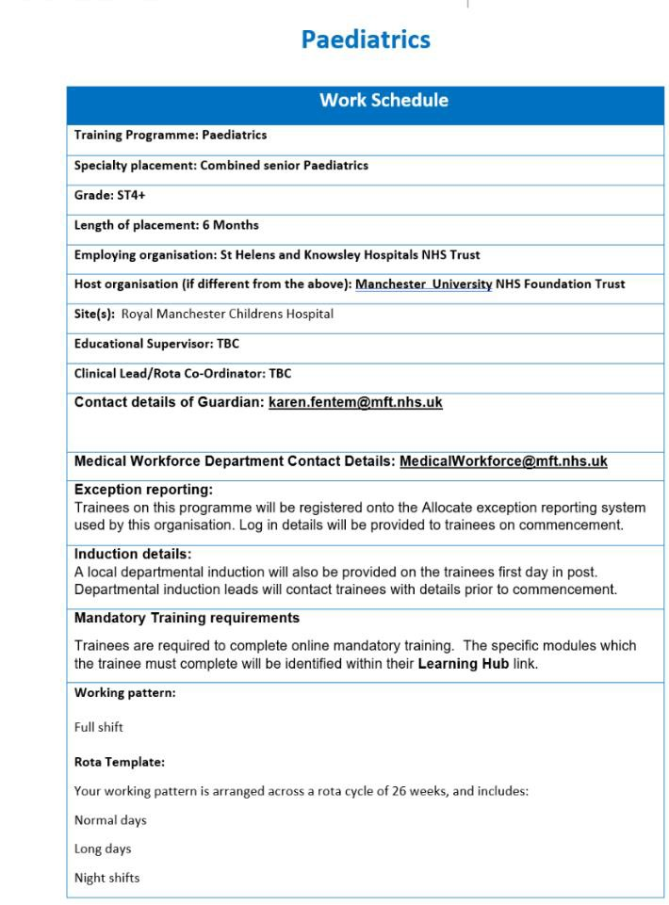
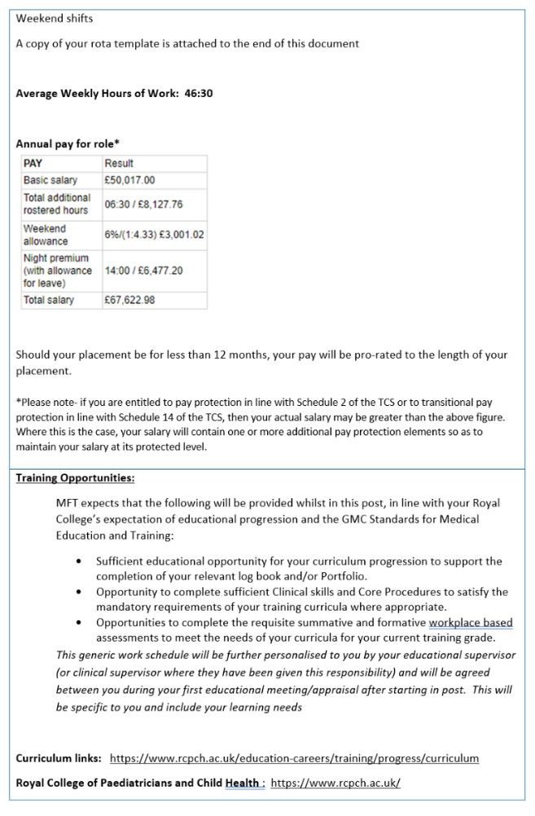
Example Work Schedule
Annual pay for role will alter with relevant nodal pay point.
Separate work schedules will be needed for each nodal point.

Slide 5
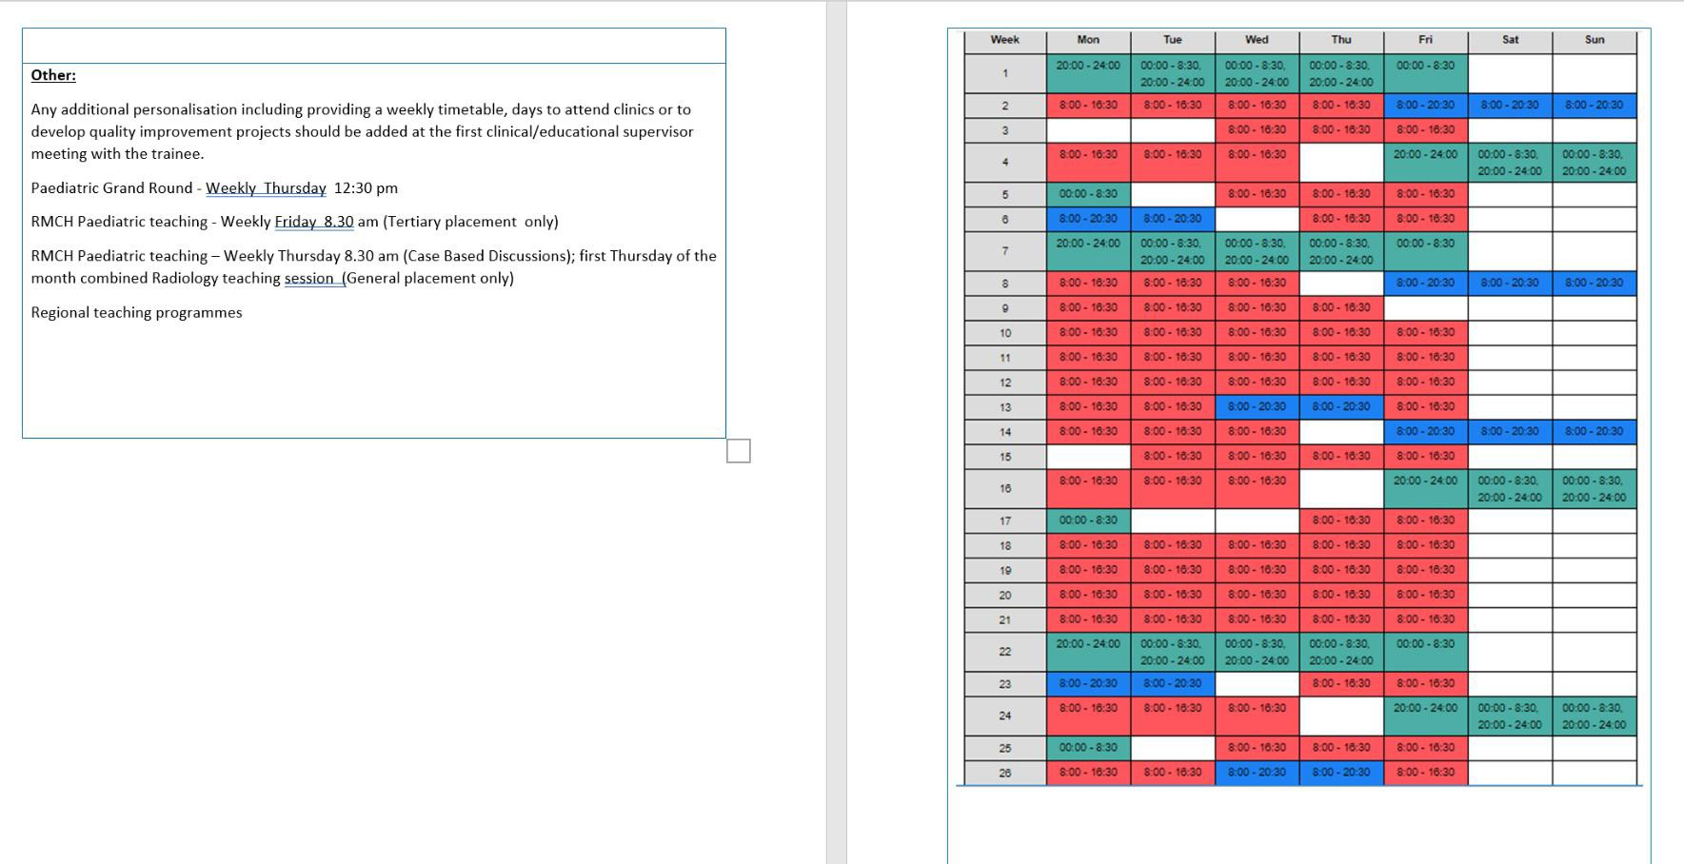
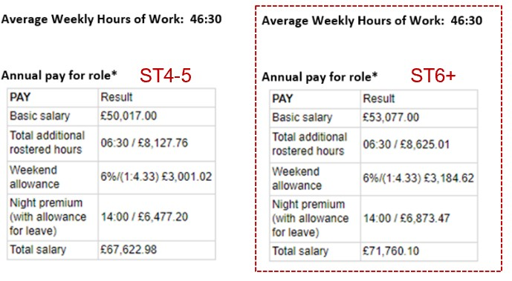

Slide 6
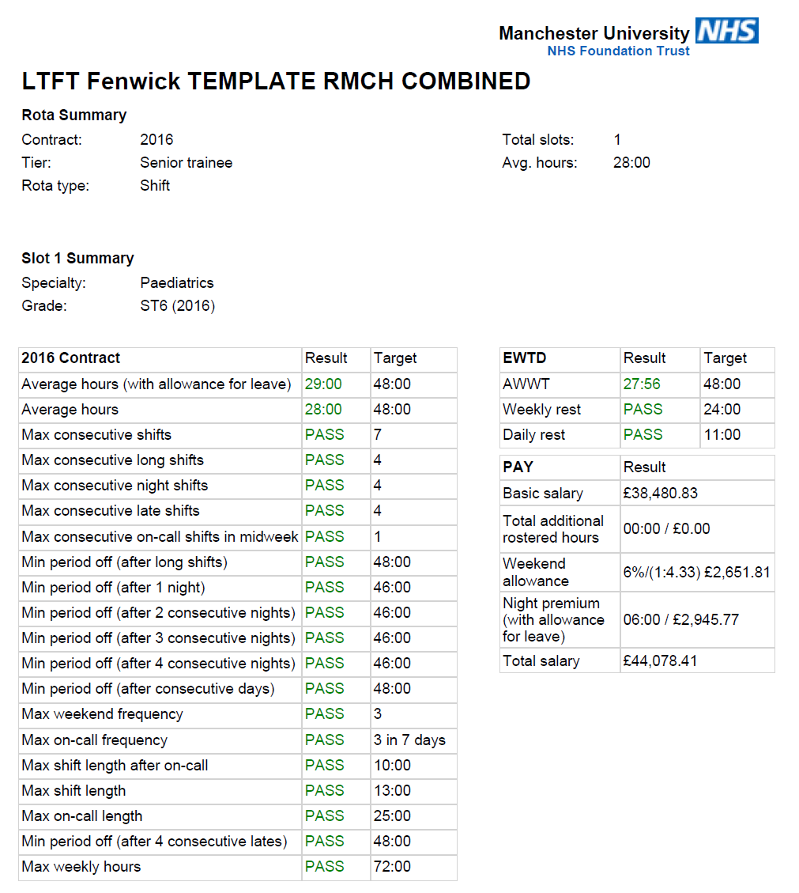
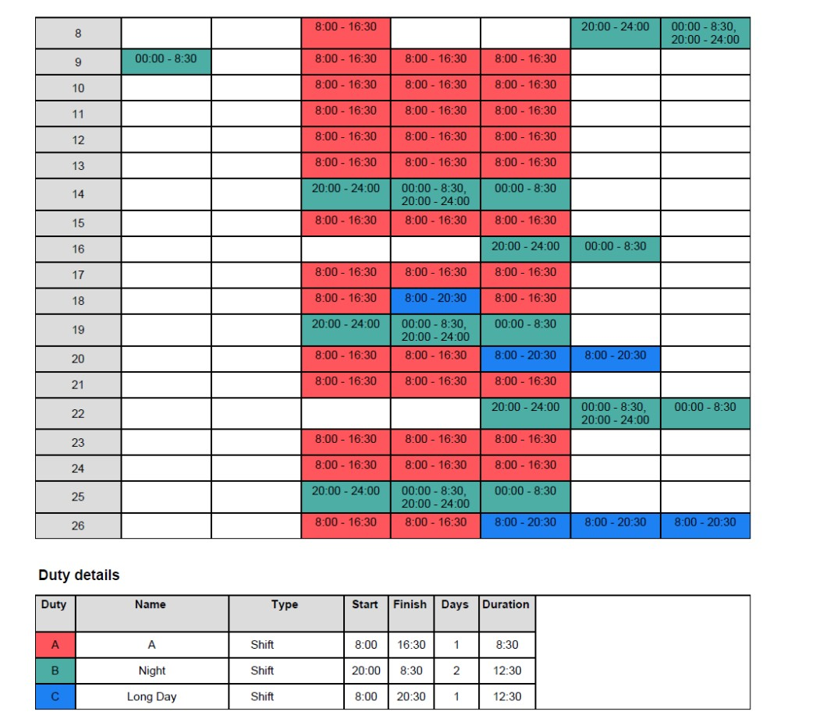
Allocate Analysis Output
Working arrangement
Duty details

Slide 7
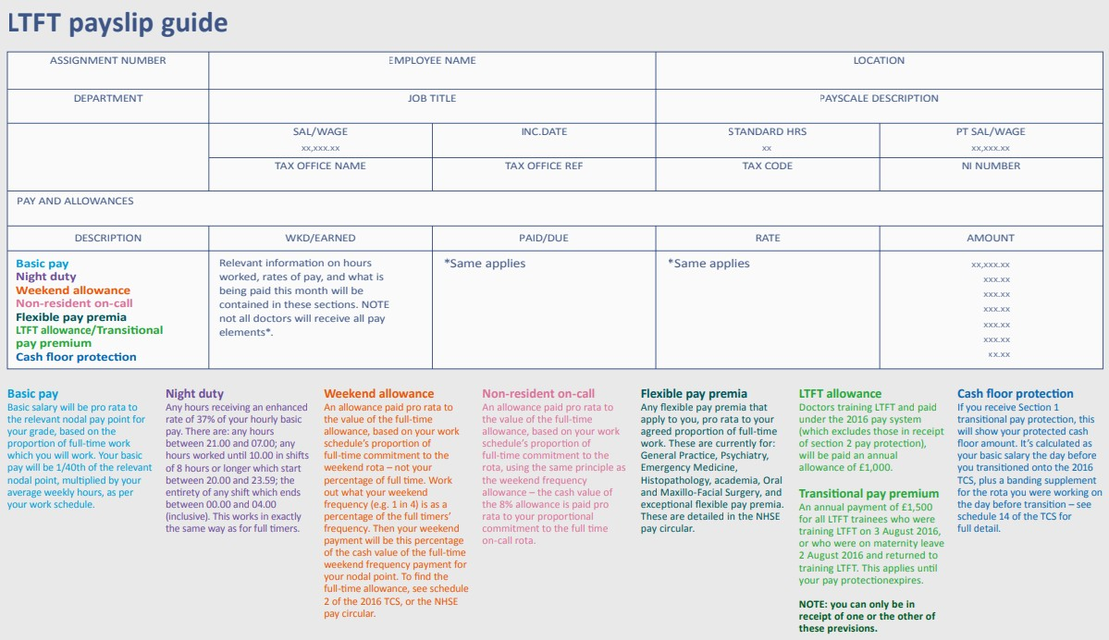

Slide 8
Pay Breakdown
2016 Pay Elements
Basic & Additional Hours.
WE Frequency Allowance.
LTFT WE Frequency Allowance.
Enhanced Hours.
On-Call Availability Allowance.
LTFT Allowance.
Flexible Pay Premia & London Weighting.

Slide 9
2016 TCS Pay Elements
2016 TCS Pay Elements Basic Pay Rate;
Hourly rate based on pay circular 40h/wk.
Additional Hours;
At basic hourly rate per additional hour.
Enhanced Rate;
Night rate, +37%.
Weekend Frequency;
% of basic full time pay.
LTFT receive proportion of FT allowance.
On-Call (NROC) Allowance;
Flat 8% of Basic Full time Salary.
LTFT receive proportion of FT allowance.
LTFT Allowance (+£1,000);
(Or 2016 Transitional LTFT Allowance).
Transitional Section 1 Pay Protection;
Cash floor pay protection (end 31.03.2023.
Transitional Section 2 Pay Protection;
2002 pay scale & banding (r/v 06.08.2025).
London Weighting Flexible Pay Premia;
Hard to fill, Academic, Exceptional etc.
Pay Protection on changing speciality etc.
•
•
•

Slide 10
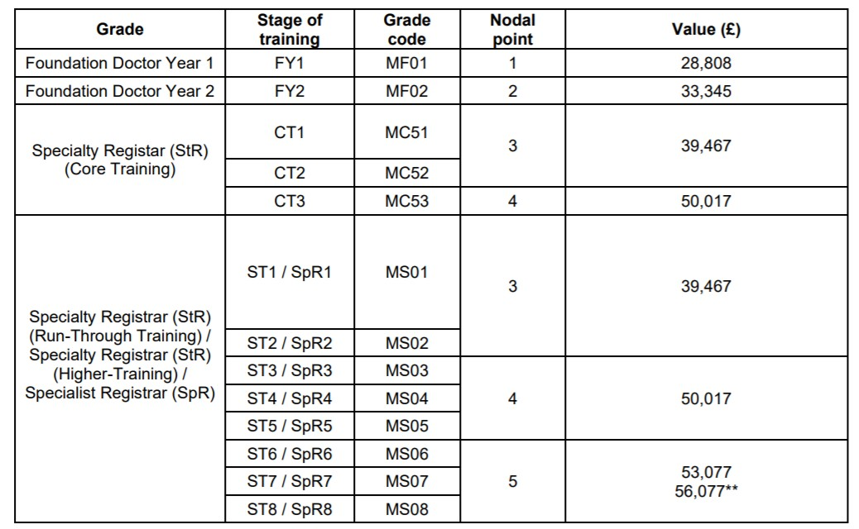
Basic & Additional Hours 2016 TCS
Full time basic pay is for 40h per week.
Additional hourly rate of pay is applied for any hours above 40h per week at basic hourly rate.
Average hours of work on the work schedule are
rounded up to the nearest ¼ hour.
Calculation of pay for additional hours is done after the application of the prospective cover of out of hour calculation (Leave adjustment).
By definition you must work <40 h/wk to be LTFT.
LTFT trainees do not have additional hours.
LTFT basic pay is calculated exactly based on your av. weekly hours from the work schedule.
Example;
0.6 LTFT ST4, working 27.25h per week
(FT nodal basic / 40) x templated LTFT hours (£50,017 / 40) x 27.25 = £34,074.08 basic hours pay
Pay & Conditions Circular (M&D) 3/2021

Slide 11
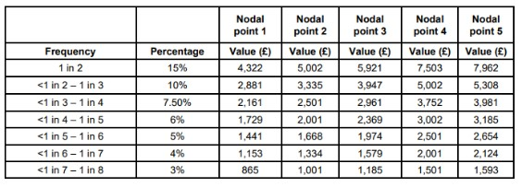
Weekend Frequency Allowance 2016 TCS
A full time trainee is paid a weekend frequency allowance (WEFA) that is calculated from;
Their nodal pay point.
Frequency of weekend working.
Weekend Frequency | % Full Time Basic Pay | Comments
1 in 2 | 15% | Absolute Safety Maximum (Including locum work)
≥ 1 in 3 | 10% | (exception via JDF & GOSW, minimum annual r/v)
≥ 1 in 4 | 7.5% | Less Than Full Time Weekend frequency allowance is calculated based on number of weekends they work as proportion of Full Time trainees weekends (see NHS Employer’s ready reckoner)
≥ 1 in 5 | 6%
≥ 1 in 6 | 5%
≥ 1 in 7 | 4%
≥ 1 in 8 | 3% | No Allowance for Weekend Frequency < 1 in 8
For the purposes of pay a weekend worked is any weekend where a shift starts between 00:01 sat morning and 23:59 Sunday night.
This is different to the definition for weekend frequency for safety maximums which is any work rostered or occurring between 00:01 sat morning and 23:59 Sunday night.
Pay & Conditions Circular (M&D) 1/2021

Slide 12
LTFT Weekend Frequency Allowance, 2016 TCS
A LTFT trainee’s WE allowance is calculated from their frequency of WE work as a proportion of the FT frequency of WE work on the full time rota.
Note, as with FT trainees this refers to weekend
frequency;
not number of weekend days.
not your training percentage .
To work out LTFT Weekend Allowance;
calculate the proportion of FT weekends.
then multiply this by the FT monetary value. for that rota.
Example:
ST5, Full time basic pay = £ 50,017 (Nodal Point 4) WE frequency 1:4 = 7.5% basic pay = £ 3,751.28
0.5LTFT, does half the number of weekends (1:8)
= £3,605.63 x ½ = £1, 875.64
0.5LTFT, does ¾ the number of weekends (1:5.33)
= £3,605.63 x ¾ = £2,813.46
0.5LTFT, does all the Saturdays (1:4)
= £3,605.63 x 1 = £ 3,751.28

Slide 13
Hours That Attract A Pay Enhancement 2016 TCS
Basic Hourly Rate +37%
Night Rate : Any hours between 21:00 – 07:00, Any Day.
Night Shift : Shift Starting between 20:00 – 23:59, >8h long, Ending before 10:00. Disco Shift : Ending after midnight & finishing by 04:00.
An average weekly total for these hours should be on your work schedule.

Slide 14
(Non-Resident) On-Call Availability Allowance (NROC) 2016 TCS
Fulltime On-Call (NROC) Rota receive an availability allowance of 8% regardless of frequency.
Similar to WE frequency, LTFT doctors receive a proportion of this, depending on their contribution to the on call rota -
not necessarily their agreed training percentage you need to know the FT & LTFT NROC frequencies to calculate this;
For instance, if the full timers do 1 in 6, LTFT does 1 in8 (¾) of full time NROC cover you would get ¾ (75%) of the full time NROC allowance (Basic nodal pay x 8% x 75% = 6%).
Where frequency isn’t directly pro rata, or is rostered in a more flexible manner, a manual option to calculate or check the allowance would be to add up the “standby hours” for the Full time & LTFT schedules (including predictable & unpredictable hours), then divide the LTFT total by FT total and x 8%;
For Example, the Full time trainees do 128 on call hours over their template, the 60% LTFT does 96h.
The LTFT allowance is therefore 96/128 x 8% = 6%.
You then get paid additionally for estimated hours (predictable & unpredictable) for NROC shifts this information
must be in your work schedule.
If your actual work exceeds this Exception Report (Pay/TOIL for additional hours at relevant rate).
If your actual work exceeds this regularly, this should trigger a work schedule review (i.e. if the work schedule does
not represent what you actually do).
•
•

Slide 15
LTFT Allowance 2016 TCS
•
•
•
•
•
Eligibility for £1,500/year LTFT transitional pay premium from 2016 TCS imposition; Section 1 (Cash Floor) pay protected;
and LTFT on 3 August 2016.
or Absent from, but continuing in, training on 2 August 2016, and you return LTFT.
Those not eligible for the £1500/year should be receiving the £1,000/year LTFT allowance (as monthly instalments), as long as they remain LTFT.
Thereafter they will drop to the £1,000/y LTFT allowance instead, as long as they remain LTFT.
Only those receiving 2016 pay elements are entitled to the £1,000 LTFT allowance So, not applicable to section 2 pay protected (2002 pay scale & banding pay).
The LTFT allowance is applied AFTER section 1 pay protection is applied (Cash floor pay protection).

Slide 16
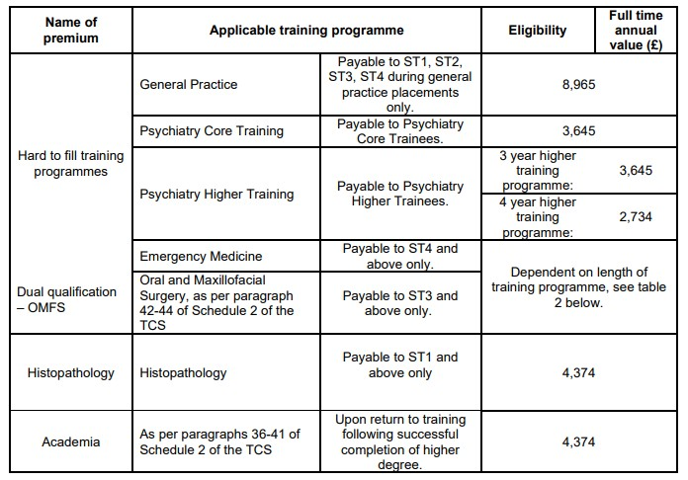
2016 TCS Flexible Pay Premia & London Weighting
2016 TCS Flexible Pay Premia & London Weighting
Pay & Conditions Circular (M&D) 1/2021
Flexible Pay Premia;
Pro rata value for agreed training percentage.
London Weighting;
Pro rata to average weekly hours as a proportion of basic 40h per week.
London Weighting Example;
Full time allowance £2,162 (for 40h/wkbasic). LTFT trainee works 27h/wk average (67.5%). LTFT trainee gets (27/40) x £2,162 = £1,459.35.

Slide 17
Further Information and guidance about your Payslip
For further guidance on how to read your payslip, please follow the link below which will take you to the relevant page on our Website
https://leademployer.sthk.nhs.uk/payroll-faqs

Slide 18
Further Information
For more information on T&Cs please visit:
https://www.nhsemployers.org/publications/doctors-and-dentists-training-terms-and-conditions-england-2016
For more information on Pay and conditions circulars for medical & dental staff please visit:
https://www.nhsemployers.org/articles/pay-and-conditions-circulars-medical-and-dental-staff
For more information on Work scheduling and templates for the 2016 junior doctor contract please visit:
https://www.nhsemployers.org/articles/work-scheduling-templates-2016-junior-doctors-contract
For any further queries please contact the Lead Employer team via email lead.employer@sthk.nhs.uk or via telephone 0151 478 7777
For further information on COGPED guidance please visit
www.bma.org.uk/media/sy2lwt5f/bma-cogped-guide-to-the-training-week.pdf

